Slide 1

Overview
  The session provides knowledge and understanding of Joins and Their Types in SQL

Slide 2
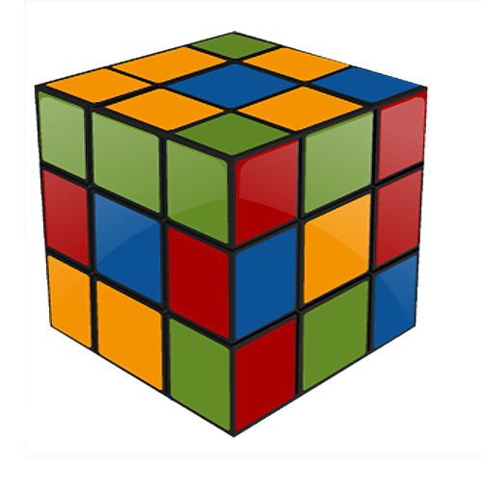
Objectives
At the end of this session, you will be able to:
  Describe INNER JOIN.
  Recognize EQUI-JOIN.
  Identify OUTER JOIN.
  Define LEFT OUTER JOIN.
  Define RIGHT OUTER JOIN.
  Identify FULL OUTER JOIN.

Slide 3
Scenario
For the complete understanding of ANSI SQL, we are going to make use of Product Management System (PMS) for ABC Traders.
ABC Traders is a company which buys collectable model cars, trains, trucks, buses, and ships directly from manufacturers and sell them to distributors across the globe. In order to manage the stocking, supply, and payment transactions, the above mentioned software is developed.
As per the requirement of the trading company, an inventory system is developed to collect the information of the products, customers, and their payment processing.
5

Slide 4
Database Tables
There are many entities involved in Product Management System.
We will be dealing with PMS throughout this session.
Offices
To maintain information of offices, for example, office code, address, city, and so on.
Customer
To maintain customer details, for example, customer name, address, and so on.
Employees
To maintain employee
details, for example, ID, name, and so on.
Products
To maintain information of products, for example, product ID, name, and so on.
Payments
To maintain information of payments done, for example, payment date, amount, and so on.
Orders
To maintain Orders done by customers, for example, order no, date, and so on.
Order Details
To maintain Orders done by customers, for example, order no, date, and so on.

Slide 5
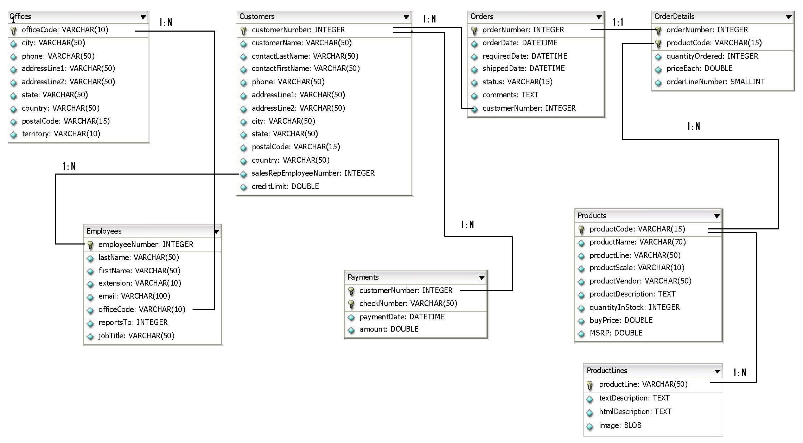
Schema Diagram

Slide 6

Do You Know?
What will be the query to SELECT data from multiple tables?
Why Join?
  SQL JOINS are used to query data from two or more tables, based on a relationship between certain columns in these tables.
  Using JOINS, you can fetch exactly the data you want from any number of tables with just one query, using any search parameter you chose to filter the results.
  Different vendors allow varying numbers of tables to join in a single join operation.
For example:
  Oracle is unlimited in the number of allowable JOINS Microsoft SQL Server allows up to 256 tables in a join operation

Slide 7
JOIN ... ON
ANSI Style: JOIN ... ON
  With JOIN ... ON, one separates the join terms from the filtering terms.
Example:
SELECT o.city, o.country, e.jobtitle
FROM offices o INNER JOIN employees e
ON (o.officecode=e.officecode)
WHERE o.country LIKE ‘%USA%’;
  It is quite clear now what belongs to what.
Note: The parenthesis is not strictly required in the ON clause.

Slide 8
JOIN ... USING
ANSI Style: JOIN ... USING
    It is the special case where we join tables on columns of the same name. We can make a shortcut and use USING.
Rewriting the previous example:
SELECT o.city, o.country, e.jobtitle
FROM offices o INNER JOIN employees e
USING (officecode)
WHERE o.country LIKE ‘%USA%’;
    This time the parenthesis is required.
Note: This ANSI syntax is supported only by: MySQL, Oracle, and DB2 databases.

Slide 9

Scenario
Ok! I would want you to stick to JOIN ..ON syntax for all my requirements!
Let us use ANSI JOIN …ON syntax in all the examples.

Slide 10
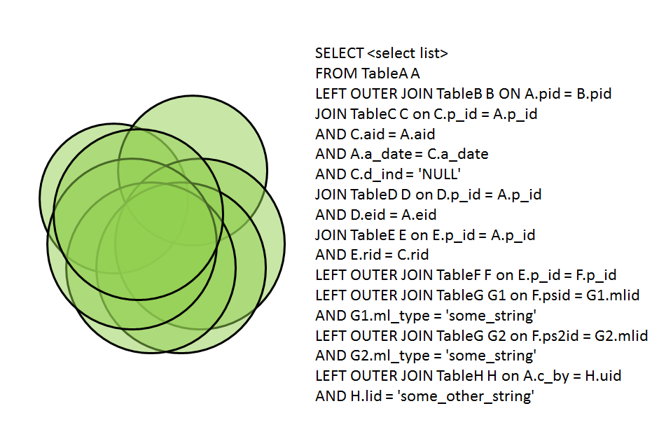

JOIN Types
JOIN Types:
  We will be looking at the following types of JOINS which are supported by almost all database vendors in market
    INNER JOIN
      EQUI-JOIN
    OUTER JOIN
      LEFT OUTER JOIN
      RIGHT OUTER JOIN
      FULL OUTER JOIN
WHAT WERE THEY THINKING
ANSI standard SQL specifies four types of JOINS: INNER, OUTER, LEFT, and RIGHT.

Slide 11
INNER JOIN
An inner join is the most common join operation used in applications and can be regarded as the default join-type.
Inner join creates a new result table by combining column values of two tables (A and B) based upon the join-predicate.
The query compares each row of A with each row of B to find all pairs of rows which satisfy the join-predicate.
When the join-predicate is satisfied, column values for each matched pair of rows of A and B are combined into a result row.
The result of the join can be defined as the outcome of first taking the Cartesian product (or Cross join) of all records in the tables (combining every record in table A with every record in table B)—then return all records which satisfy the join predicate.

Slide 12

Scenario
I want to display all rows from selected columns in offices and employees tables where ever there is a match between office codes. Help me do that!
Let us use INNER JOIN to meet Tim’s requirement.

Slide 13
INNER JOIN (Contd.)
ANSI Style:
    SELECT o.city, o.country, e.jobtitle
    FROM offices o INNER JOIN employees e
    ON o.officecode=e.officecode;
  The query given in the example above will join the offices and employees tables using the officecode column of both tables.
  The query returns all rows from the offices and employees tables where there is a matching officecode value in both the tables.
  Where the officecode does not match, no result row is generated.

Slide 14
INNER JOIN (Contd.)
Programmers should take special care when joining tables on columns that can contain NULL values, since NULL will never match any other value (not even NULL itself), unless the join condition explicitly uses the IS NULL or IS NOT NULL predicates.
INNER JOIN can be classified further into the following types. These will be discussed in the ensuing slides.
  EQUI-JOIN
  NATURAL JOIN

Slide 15
EQUI-JOIN
An EQUI-JOIN is a specific type of comparator-based join, that uses only equality (=) comparisons in the join-predicate.
Using other comparison operators (such as <,>,<=,>=) disqualifies a join as an EQUI-JOIN. The query shown before has already provided an example of an EQUI-JOIN.
ANSI Style:
  SELECT o.city, o.country, e.jobtitle
  FROM offices o INNER JOIN employees e
  ON o.officecode=e.officecode;

Slide 16
OUTER JOIN
An OUTER JOIN does not require each record in the two joined tables to have a matching record.
The joined table retains each record—even if no other matching record exists.
OUTER JOINS divides further into the following, depending on the table's rows that are retained:
  LEFT OUTER JOIN or LEFT JOIN
  RIGHT OUTER JOIN or RIGHT JOIN
  FULL OUTER JOIN
    (In this case left and right refer to the two sides of the JOIN keyword.)
No implicit join-notation for OUTER JOINS exist in standard SQL (which implies you must use either LEFT /RIGHT/FULL, just OUTER JOIN will not work).

Slide 17
Scenario
I want to display selected columns from customers and payments tables in such a way that all rows from customers table are displayed irrespective of whether there is a match in payments or not.
Let us use LEFT JOIN to meet Tim’s requirement.

Slide 18
LEFT OUTER JOIN
The result of a LEFT OUTER JOIN (or simply left join) for table A and B always contain all records of the "left" table (A), even if the join-condition does not find any matching record in the "right" table (B).
This means that if the ON clause matches 0 (zero) records in B (for a given record in A), the join will still return a row in the result (for that record)—but with NULL in each column from B.
A LEFT OUTER JOIN return all the values from an inner join and all values in the left table that do not match with the right table.
ANSI Style:
SELECT c.city, p.checknumber, p. amount
FROM customers c LEFT OUTER JOIN payments p
ON c.customernumber=p.customernumber;

Slide 19
Scenario
I want to display selected columns from customers and payments tables in such a way that all rows from payments table are displayed irrespective of whether there is a match in customers or not.
Let us use RIGHT JOIN to meet Tim’s requirement.

Slide 20
RIGHT OUTER JOIN
A RIGHT OUTER JOIN (or right join) closely resembles a LEFT OUTER JOIN, except with the treatment of the tables reversed.
Every row from the "right" table (B) will appear in the joined table at least once.
If no matching row from the "left" table (A) exists, NULL will appear in columns from A for those records that have no match in B.
A RIGHT OUTER JOIN returns all the values from the right table and matched values from the left table (NULL in case of no matching join predicate).
ANSI Style:
SELECT c.city, p.checknumber, p. amount
FROM customers c RIGHT OUTER JOIN payments p
ON c.customernumber=p.customernumber;

Slide 21
Scenario
Combine the effect of applying both LEFT and RIGHT OUTER JOINS on
customers and payments tables.
Let us use FULL OUTER JOIN to meet Tim’s requirement.

Slide 22
FULL OUTER JOIN
Conceptually, a FULL OUTER JOIN combines the effect of applying both LEFT and RIGHT OUTER JOINS.
Where records in the FULL OUTER JOINed tables do not match, the result set will have NULL values for every column of the table that lacks a matching row
For those records that do match, a single row will be produced in the result set (containing fields populated from both tables)
Supported: Microsoft SQL Server, DB2, Oracle 10g, 11g
Not Supported: MySQL, Sybase
ANSI Style:
SELECT c.city, p.checknumber, p. amount
FROM customers c FULL OUTER JOIN payments p
ON c.customernumber=p.customernumber;

Slide 23
FULL OUTER JOIN (Contd.)
Some database systems do not support the FULL OUTER JOIN functionality directly, but they can emulate it through the use of an INNER JOIN. UNION ALL selects the "single table rows" from left and right tables respectively.
Example:
SELECT c.city, p.checknumber, p. amount FROM customers c
LEFT JOIN payments p ON c.customernumber=p.customernumber
UNION
SELECT c.city, p.checknumber, p. amount FROM customers c
RIGHT JOIN payments p ON c.customernumber=p.customernumber;

Slide 24
Hands-on
Yeah!
Now that we are well versed with JOIN and various types of JOINS, let’s help Tim to find answers to his complicated queries for online feedback system.
Please check the hands-on document for more details.

Slide 25
Activity
Now that we are well versed with commands, let’s test our understanding using a short case study.
Course Management System (CMS) ABC University
Case Study Scenario:
  This case study is to develop a Course Management System (CMS) for ABC University. The following are the two use cases for which the database needs to be designed.
  Add Course
  To add the course details into the course management system.
  Retrieve Course
  Retrieve the courses stored in the system and display them.
  The courses to be added will have the following attributes course code, course name, number of participants, course description, course duration, course start date, and course type.
54

Slide 26

Lend a Hand
Requirement #1: Write a query to fetch student ID, first name, last name, and course code for students who have enrolled for course having course_code as 167. Student_Info and student_courses to be queried.
Requirement #2: Write a query to display the discount offered on the courses along with course descriptions.
Pre-requisite for Requirement #3: Create a student record (student_info_ <employee id>).
Note: Do not create any other detail regarding this student in any other table.
Requirement #3: Write a query to fetch first names of the students along with the course codes of the courses they have enrolled in.
Note: Even if the course_code does not exist for a student, the record needs to be fetched.
Get the same output as per the requirement above using:
  Left Join
  Right Join

Slide 27
Lend a Hand: Solution
Solution 1:
SELECT s.student_id, s.first_name, s.last_name, s.address, c.course_code
FROM student_info INNER JOIN student_course
ON s.student_id = c.student_id WHERE c.course_code = 167;
Solution 2:
SELECT cf.discount, ci.course_description
FROM course_fees cf INNER JOIN course_info ci
ON cf.course_code=ci.course_code;
Solution 3(a):
SELECT si.first_name, sc.course_code
FROM student_info si LEFT JOIN student_courses sc
ON si.student_id = sc.student_id;
Solution 3(b):
SELECT first_name, course_code
FROM student_courses sc RIGHT JOIN student_info si
ON sc.student_id = si.student_id;

Slide 28

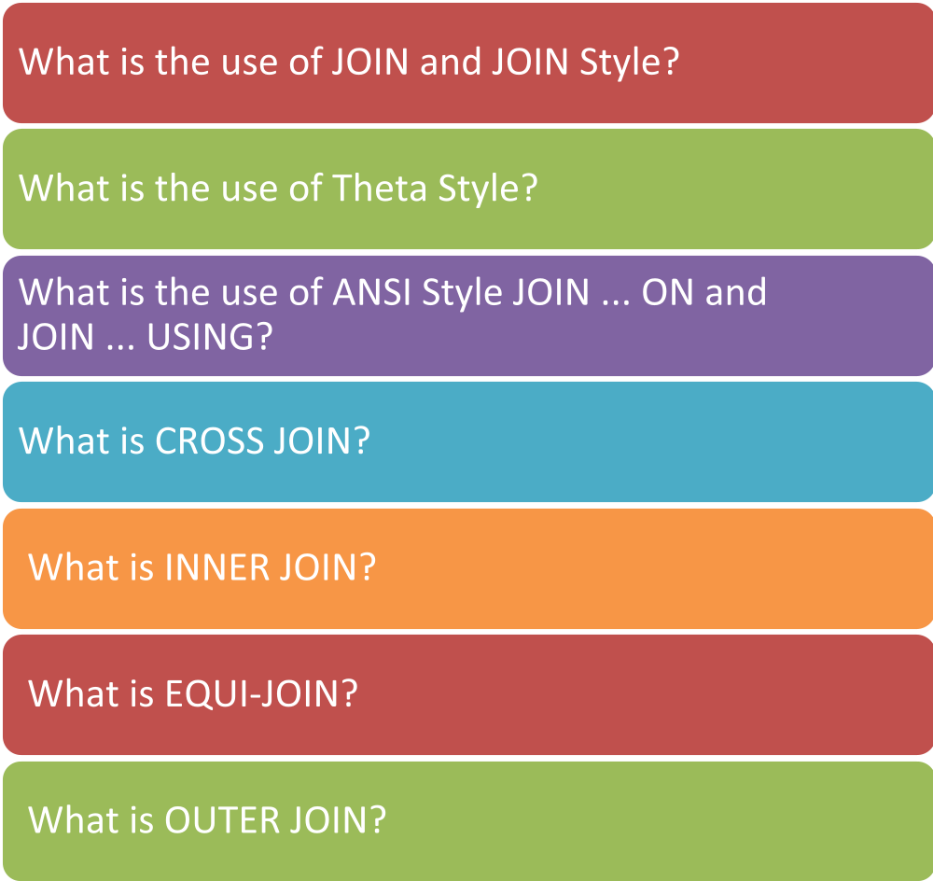

Test Your Understanding

Slide 29
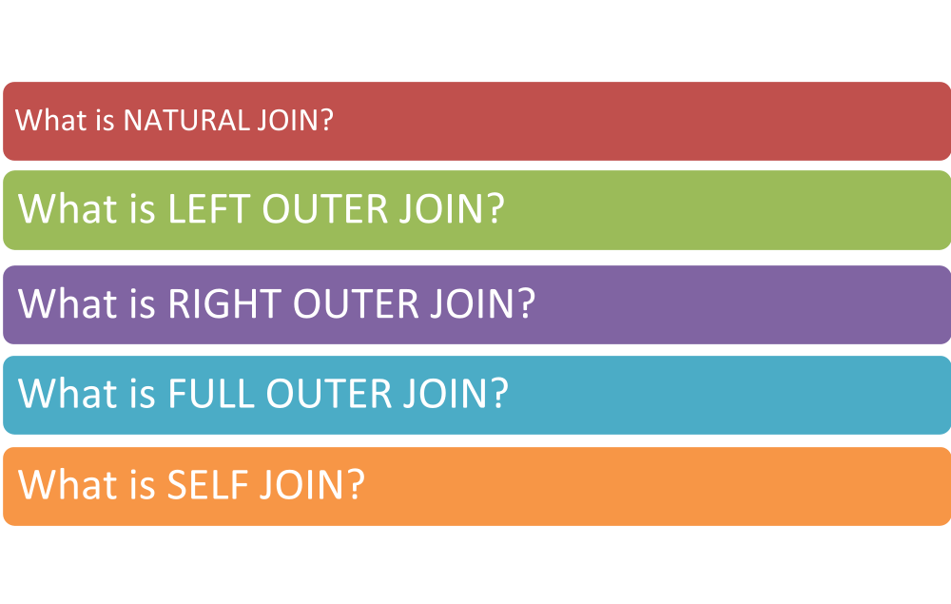
Test Your Understanding

Slide 30
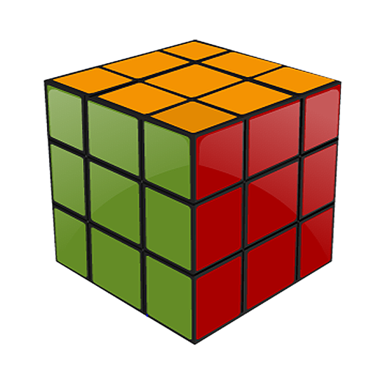
Summary
The key points covered in this chapter are:
  SQL JOINS are used to query data from two or more tables, based on a relationship between certain columns in these tables.
  JOINS are of two types:
      Theta Style and ANSI style
  CROSS JOIN returns the Cartesian product of rows from tables in the join
  Inner join creates a new result table by combining column values of two tables (A and B) based upon the join-predicate
  The details of Outer JOIN, CROSS JOIN, LEFT OUTER JOIN, RIGHT OUTER JOIN, FULL OUTER JOIN, and SELF JOIN.

